Slide 1


Pathfinding Tools
Pathfinding Algorithms
Interactive Comparison of Algorithms
PRESENTED BY
SATURN

Slide 2
Understanding Pathfinding Algorithms in Depth
EXPLORING THEIR SIGNIFICANCE ACROSS DISCIPLINES
Pathfinding algorithms are essential in computer science and robotics, influencing areas like AI and game development, where they solve critical navigation problems through efficient search techniques.

Slide 3

Understanding Challenges
Pathfinding algorithms face significant challenges, including the balance between speed and optimality, which often confuses students learning about informed and uninformed searches.

Slide 4

Problem Statement
The theoretical explanations of pathfinding algorithms often lack visual clarity, making it hard for learners to grasp their inner workings and practical applications.

Slide 5
Project Objectives of the Interactive Tool
DESIGNING AN EDUCATIONAL PATHFINDING EXPERIENCE
The project aims to create an interactive web-based tool for comparing pathfinding algorithms, enhancing student understanding through visualizations of search behaviors, metrics, and user engagement.

Slide 6
Features of the Tool
MAZE GENERATION
The tool features dynamic maze generation, allowing users to customize the size and complexity of the maze easily. This variability helps test the robustness of different algorithms.
ALGORITHM VISUALIZATION
Real-time visualization displays each algorithm's progress, showing explored nodes and final paths on an HTML5 Canvas. This enhances understanding of search behaviors and decision-making processes.

Slide 7

Target Audience
This project is designed for students, educators, and researchers interested in understanding pathfinding algorithms through interactive exploration and practical application in computer science.

Slide 8
Algorithms Implemented: A* Search Algorithm
UNDERSTANDING THE MECHANICS OF A* PATHFINDING

Slide 9
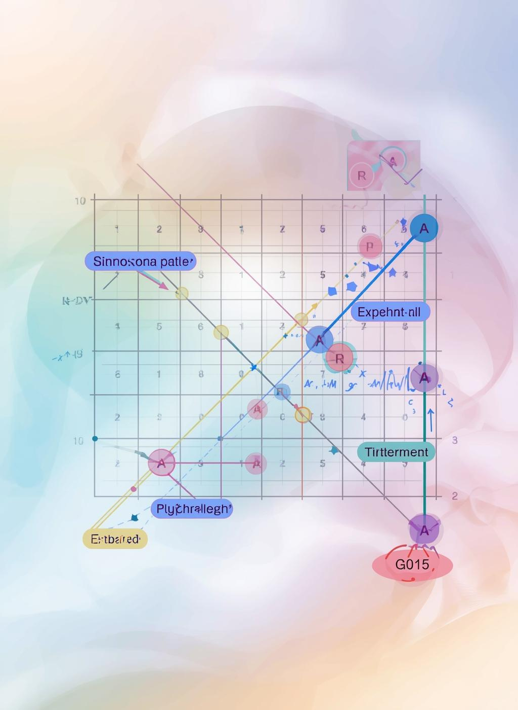
A* Search Algorithm
The A* search algorithm is an informed pathfinding technique, combining the strengths of both Dijkstra's Algorithm and Greedy Best-First Search, ensuring optimality in diverse scenarios.

Slide 10
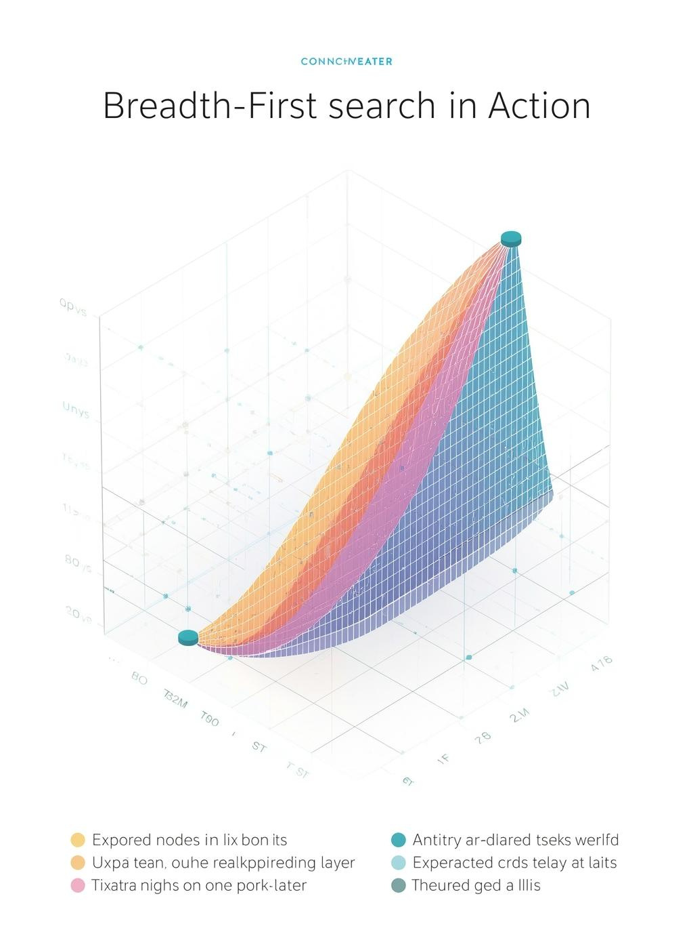
Breadth-First Search (BFS)
Breadth-First Search (BFS) is an uninformed search algorithm that explores nodes level by level, making it reliable for finding the shortest path in unweighted grids.

Slide 11
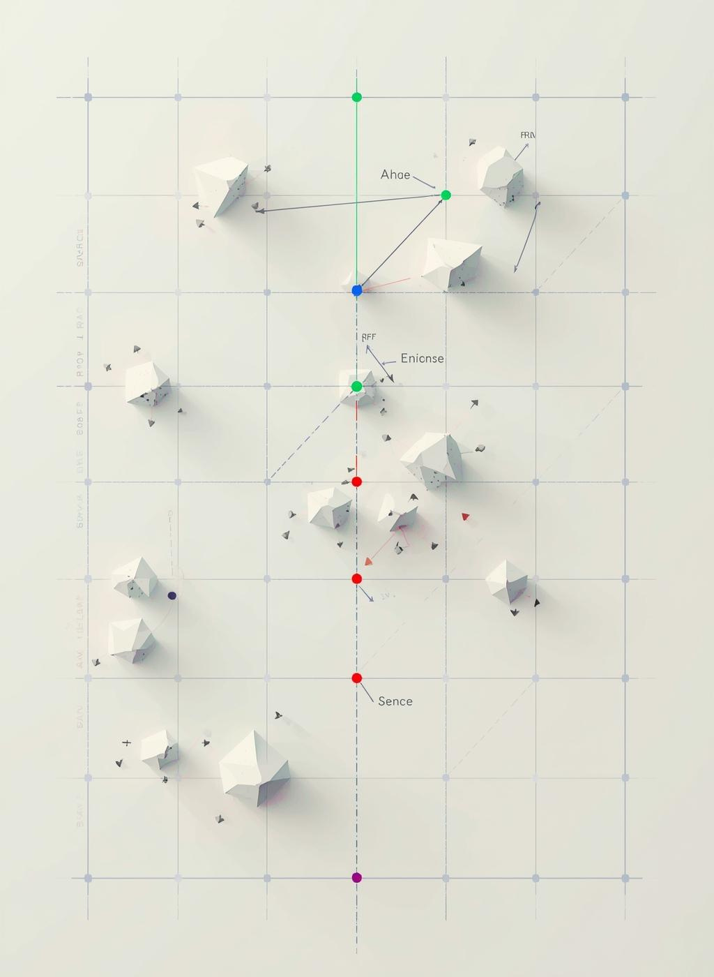
Greedy Best-First Search
The Greedy Best-First Search algorithm prioritizes the most promising nodes based solely on a heuristic, which may lead to faster execution but can sacrifice optimality in the search process.

Slide 12
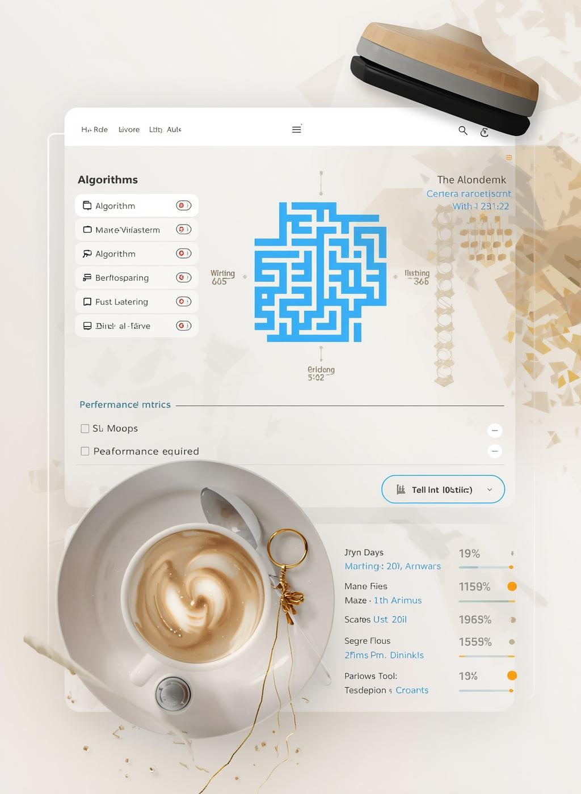
User Interface
The interface is designed for modular testing, allowing users to independently evaluate each algorithm. This approach enhances clarity and promotes a deeper understanding of pathfinding techniques.

Slide 13
Key Features of Dynamic Maze Generation
EXPLORING ADJUSTABLE PARAMETERS FOR MAZE CREATION
Our tool enables users to dynamically generate random mazes with customizable size and obstacle density, enhancing the learning experience by allowing real-time interaction and exploration of pathfinding algorithms.

Slide 14

Real-Time Visualization
The tool provides dynamic feedback on algorithm performance, showcasing real-time execution through visual representations, allowing users to witness the search process and its progression.

Slide 15

Performance Statistics
This section details the performance metrics captured during algorithm execution, emphasizing the importance of client-side implementation for transparency and user experience.

Slide 16
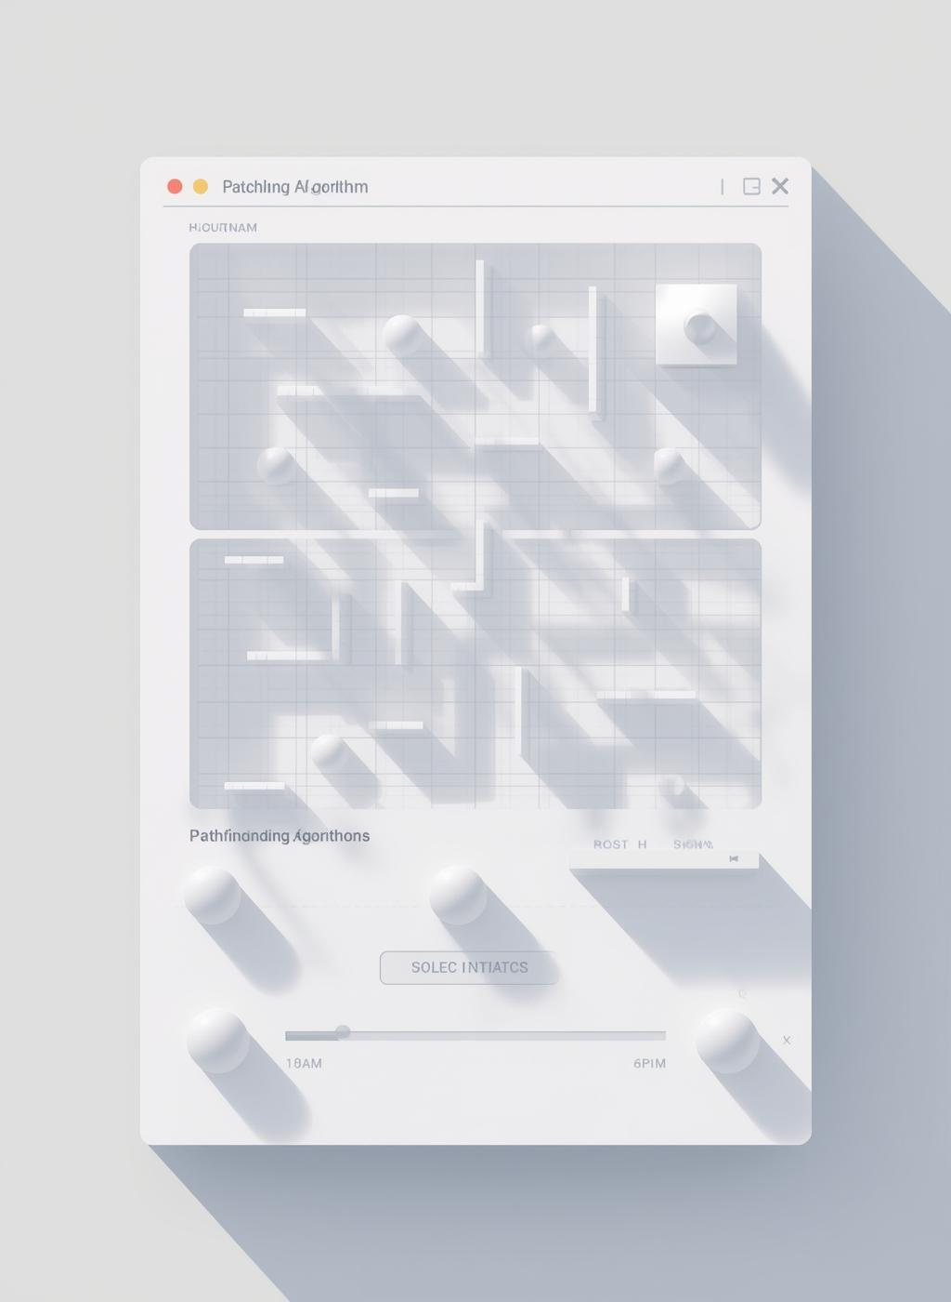
User Interface Design
The user interface is designed for intuitive interaction, allowing users to easily navigate through algorithms and visualize pathfinding processes, enhancing understanding through direct engagement.

Slide 17
Technologies Implemented: HTML5, CSS3, JavaScript
LEVERAGING MODERN WEB TECHNOLOGIES FOR CLARITY
This project utilizes HTML5 for structure, CSS3 for styling, and JavaScript ES6 for algorithm functionality, ensuring a lightweight and transparent educational tool without external libraries.

Slide 18

Clarity and Transparency
This project emphasizes clarity and transparency in algorithm implementation, ensuring that learners can easily understand and visualize the inner workings of each pathfinding algorithm.

Slide 19
Overview of the Maze Generator Module
DYNAMIC 2D GRID CREATION FOR TESTING
The Maze Generator creates random 2D grids with configurable obstacle density, ensuring variability for robust testing of pathfinding algorithms and allowing users to explore various scenarios.

Slide 20
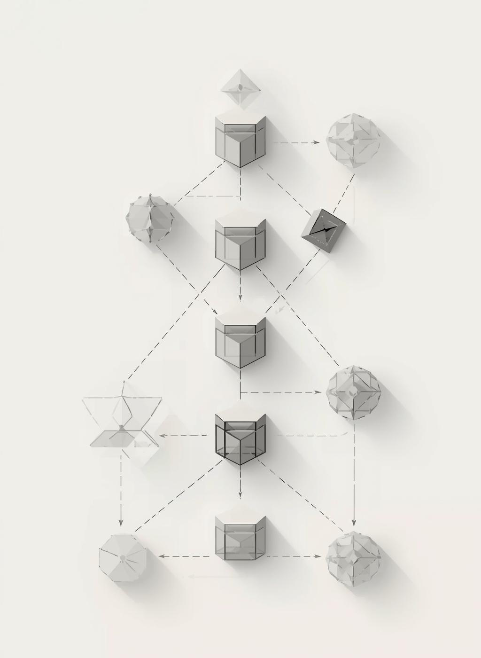
Algorithm Dispatcher
The algorithm dispatcher module is responsible for routing control flow to the selected pathfinding algorithm, ensuring efficient execution and streamlined comparisons among different methods.

Slide 21
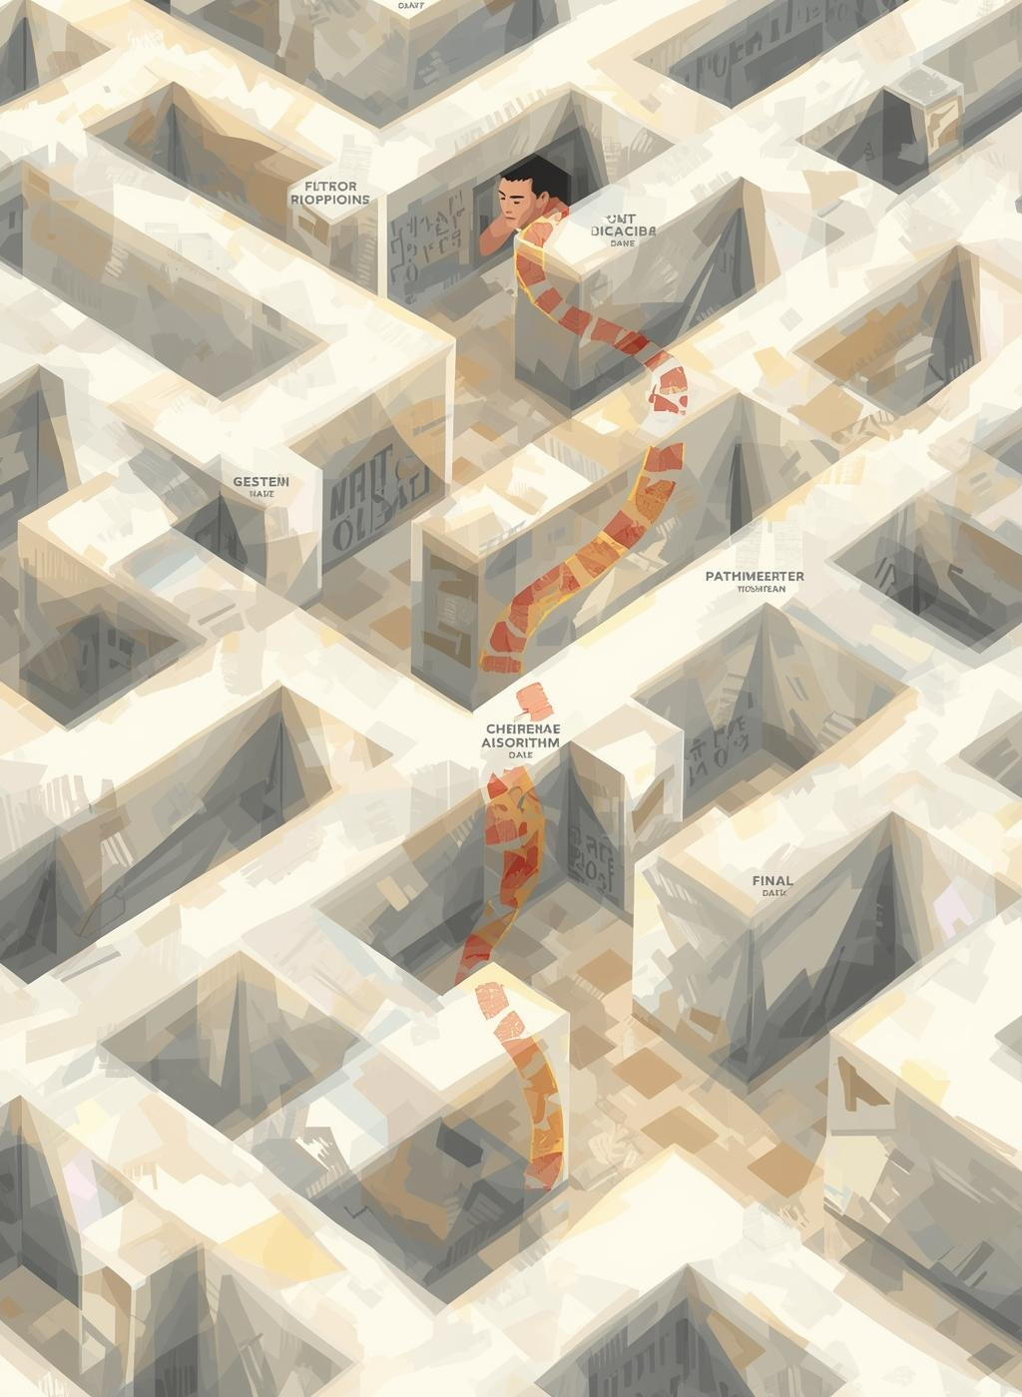
Search Engine Module
The Search Engine module executes the selected pathfinding algorithm, meticulously tracking each node visited and the final path to provide insights into algorithm behavior.

Slide 22

Visualization Engine
The Visualization Engine is crucial for rendering real-time interactions, showcasing algorithm progress, and displaying various elements like walls, explored nodes, and final paths effectively on the Canvas.

Slide 23

Metrics Analyzer
The Metrics Analyzer module is crucial for evaluating algorithm performance. It collects data on path length, nodes explored, and execution time to enhance understanding.

Slide 24
Enhancing Learning through Interactive Tools
CONNECTING THEORY WITH PRACTICAL APPLICATION
This project offers a visual and interactive approach, helping students understand pathfinding algorithms by bridging abstract concepts with hands-on experience in a user-friendly environment.

Slide 25

Informed vs Uninformed
This section explores the key differences between informed and uninformed search algorithms, highlighting their methodologies, effectiveness, and implications in various applications of pathfinding.

Slide 26
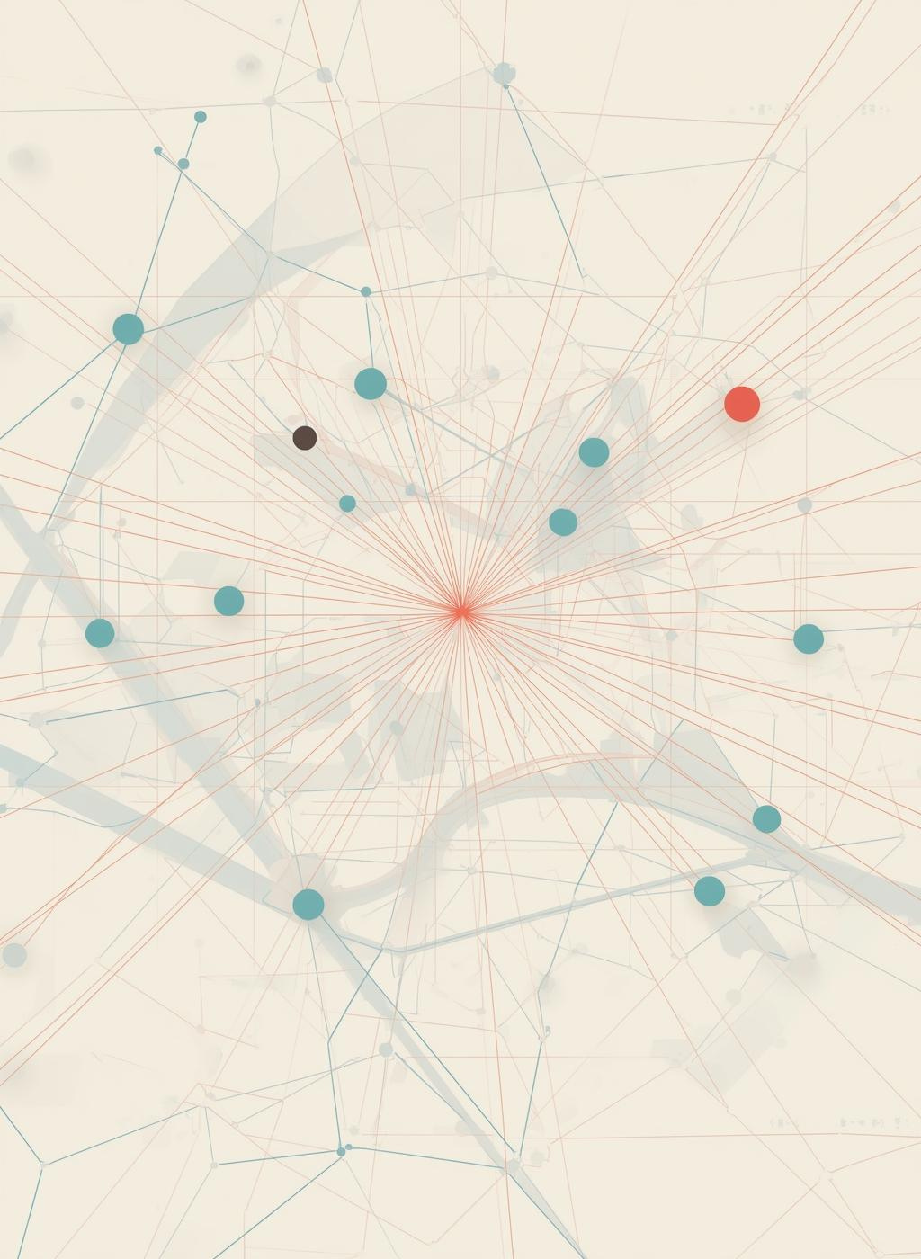
Algorithm Experimentation
This section discusses how the interactive tool allows users to experiment with various maze parameters and algorithms, enhancing their understanding of different pathfinding strategies.

Slide 27
Limitations of Movement and Maze Generation
CONSTRAINTS IMPACTING PATHFINDING ALGORITHM PERFORMANCE
The movement is restricted to four directions with uniform costs, and random maze generation may produce unsolvable configurations, affecting the exploration and learning experience of algorithms.

Slide 28

Future Enhancements
As we look towards the future, there are numerous opportunities to expand and enhance the interactive pathfinding tool, making it even more valuable for learners.

Slide 29
Algorithm Comparison
BFS CHARACTERISTICS
Breadth-First Search guarantees the shortest path in unweighted grids, expanding nodes level-by-level. It is reliable but explores many unnecessary nodes, leading to high memory usage.
A* CHARACTERISTICS
A* Search utilizes a heuristic to efficiently find the shortest path, balancing exploration and optimality. Its performance heavily relies on the quality of the heuristic used.

Slide 30
Comparison of Algorithms
GREEDY BEST-FIRST
Greedy Best-First Search is fast and efficient but sacrifices optimality. It primarily focuses on immediate proximity to the goal, which may lead to suboptimal paths in complex scenarios.
A SEARCH*
A* Search combines heuristics with path cost, ensuring optimal solutions. Its reliance on a well-designed heuristic allows for efficient exploration, making it suitable for various pathfinding applications.

Slide 31
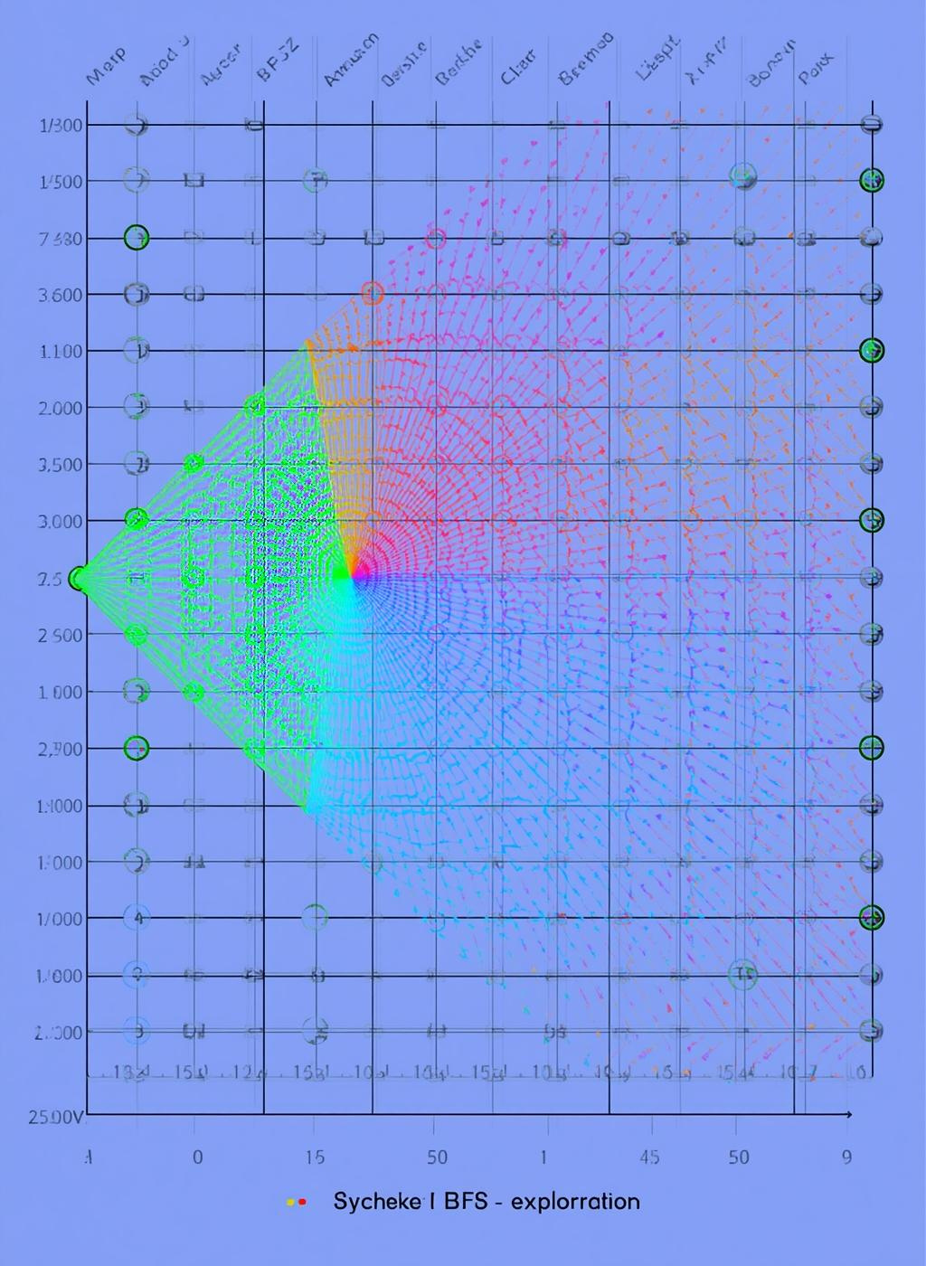
Breadth-First Search (BFS)
Breadth-First Search (BFS) is an uninformed search algorithm that explores nodes level by level, guaranteeing the shortest path in unweighted grids while often exploring many unnecessary nodes.

Slide 32
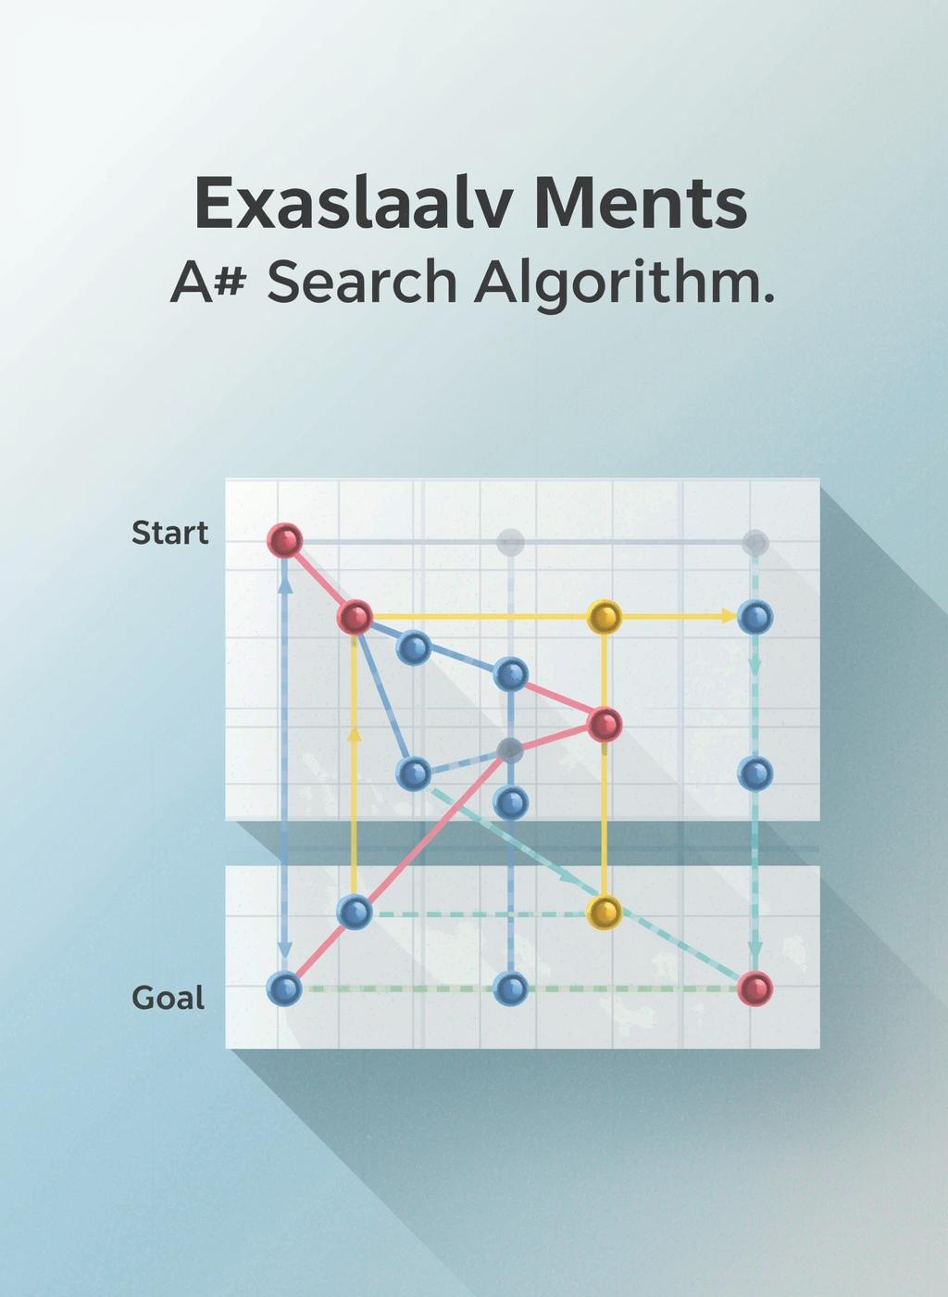
A* Search Analysis
The A* Search Algorithm is a powerful pathfinding technique, combining the strengths of both informed and uninformed search strategies to efficiently find the shortest path in various applications.

Slide 33
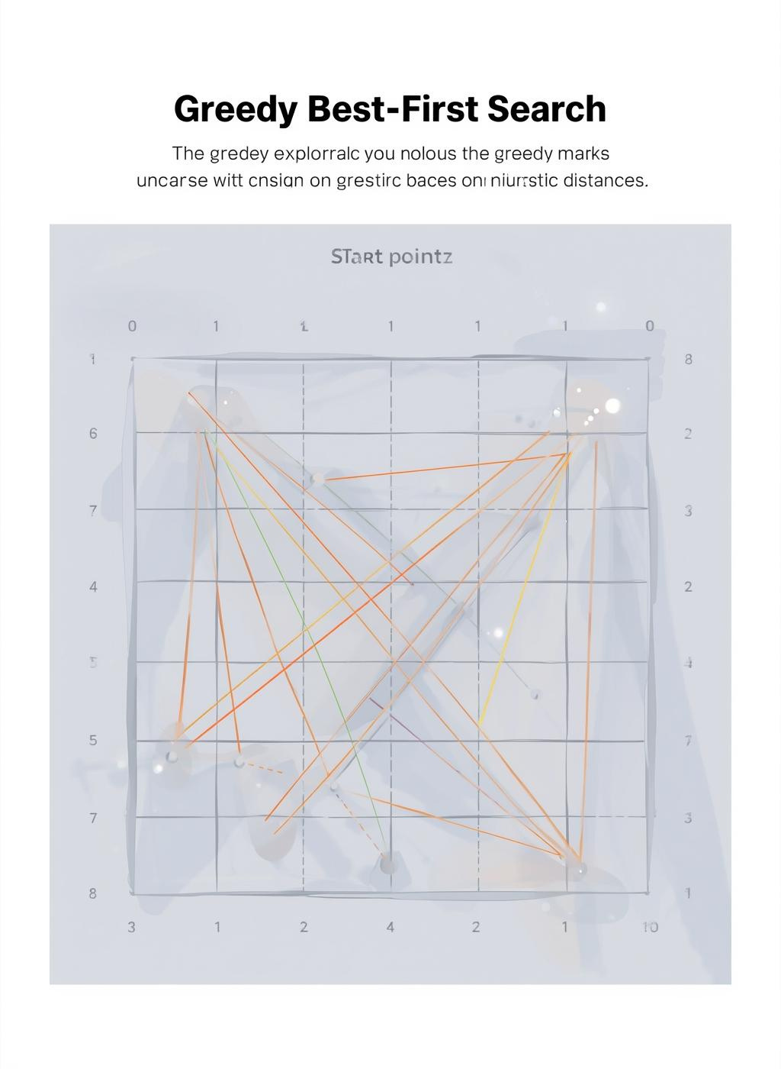
Greedy Best-First Search
Greedy Best-First Search is an informed algorithm that prioritizes the most promising nodes based on heuristic evaluations, leading to quick but potentially non-optimal solutions.

Slide 34

Practical Recommendations
Choosing the right pathfinding algorithm depends on specific use cases; understanding each algorithm's strengths helps in making informed decisions for various applications and scenarios.

Slide 35
Recap of Project Objectives and Achievements
INTERACTIVE TOOL FOR ALGORITHM COMPARISON
This project successfully developed an interactive web-based tool that allows users to compare pathfinding algorithms, enhancing understanding through visual clarity and practical engagement with algorithmic concepts.

Slide 36

Educational Clarity
This project provides visual clarity for learners, enhancing understanding of pathfinding algorithms by bridging theoretical concepts with practical, interactive experiences in a user-friendly format.

Slide 37

Thank You
Explore, experiment, and deepen your understanding of pathfinding algorithms through interactive tools and engaging learning experiences, fostering a solid foundation in computational problem-solving.

